Slide 1





Slide 2




Steven Hillaert
Technical Coach @ AllPhi
Developing software
for +20 years
Now focused on
developing people
tech & non-tech
Contact me:
in/stevenhillaert

Slide 3

Log it like it’s hot
That warm fuzzy blanket when production is down
Steven Hillaert

Slide 4

WHY SHOULD WE HAVE LOGGING
SO WE KNOW WHAT IS GOING ON
Why is it only crashing in production?
Speedup debugging.
It’s not the user’s responsibility to give you all the details!
Become proactive when issues arise.
Make logs valuable data.
A system behaves
as it was developed,
not as it was intended.

Slide 5
STRUCTURED LOGGING
WHAT
Store structured data, like a database.
WHY
Real data to work with, it’s queryable! It allows for dashboards, alerts, …
HOW
Use proper logging library (Serilog).
Use proper log server/service (Seq, ELK stack…).
Stop using Console.WriteLine() or text files.
TIP
Never ever use any form of string concatenation!
Searching for a needle in a haystack is easier when the haystack is organized.

Slide 6
AUTOMATE LOGGING
WHAT
Collect data without explicit log statements.
WHY
Developers are focused on their current task, not on the support ticket in 1 month.
We’re lazy, so let’s be lazy in a smart way.
HOW
Plug logging in the frameworks and libraries we use
→ dotnet (middleware), MassTransit, Mediatr, …
Let the system write down its own diary,
so we don't have to.

Slide 7
ENRICHMENT
WHAT
Add details to every log in scope.
Without explicitly logging them. → request id, user, order reference, …
WHY
No need to think about it, consistency.
And because we’re lazy.
HOW
Use proper logging library (Serilog).
Sprinkling extra context onto our logs, turning plain notes into enlightening tales.
Notes:
Example of adding request id to every log statement in an api.

Slide 8
CORRELATION ID’s
WHAT
Identifier, passed from the origin to every app/service involved.
WHY
Know everything that executed in your whole system when a user pressed a button.
HOW
Pass a correlation id when crossing application boundaries.
traceparent
Like correlation id but more detailed: hierarchical relationship. Distributed tracing.
The breadcrumbs that connect the dots, making sense of the journey across system boundaries.
Notes:
Most applications are not an island.
They’re part of a bigger system and need to communicate with other applications.
How do we track and correlate logs from different applications.

Slide 9
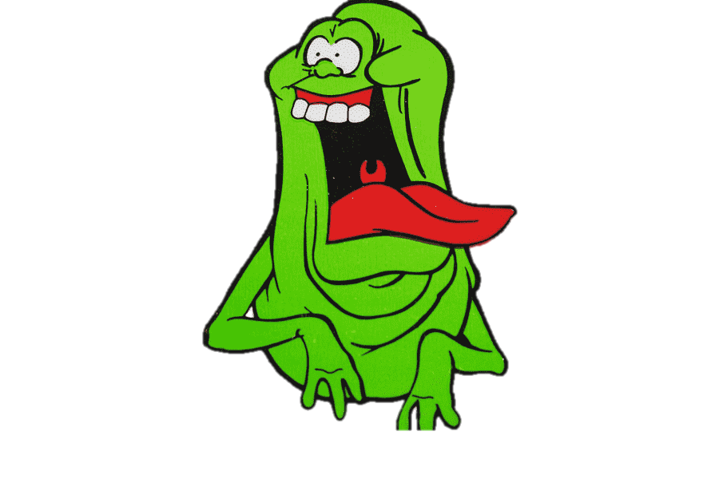
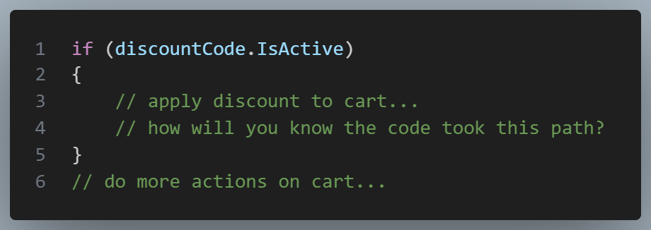
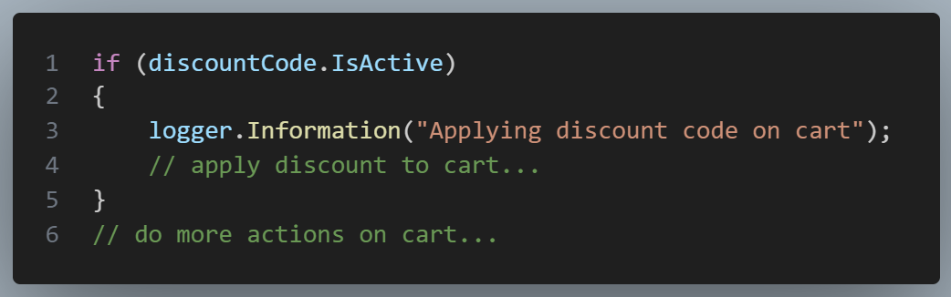
LOG DECISIONS
WHY
Know what’s happening and follow the flow of your code in production.
Map out the thought process of your code.
So you can trace its every choice and detour.

Slide 10
REAL ERRORS
WHY
Errors should be (proactively) acted upon.
When everything is an error, nothing is an error.
HOW
Use correct log levels for your messages.
Don’t flood your system with logs you’ll never look at.
TIP
Dynamically change minimum level at runtime .
Only raise the alarm for true threats,
not every shadow that passes by.
Notes:
Imagine a system that logs 1000’s of errors per day.
How do you distinguish real errors from fake ones.
This creates “alert fatigue”

Slide 11

Performance metrics
WHY
Easily find slow queries.
Performance degradation, after release. Diff between framework and own logic.
HOW
Use timing library, don’t use stopwatch!
TIP
If response time > threshold, log as warning or error.
Our early warning system, catching the subtle hints of wear and tear before they become major roadblocks.
Notes:
Diff case: deserialization of large json, extra overhead in framework part but not in your own logic.

Slide 12
Be careful when logging objects
WHY
Structured logging makes it tempting to just log an entire object (graph).
→ impact on performance and resources
HOW
Log only what you need to know.
exclude with attributes
limit depth
use separate log models
Capturing every brushstroke
of a masterpiece;
beautiful in detail but demanding on the canvas of performance.
Notes:
Real life cases.

Slide 13
Sensitive data
WHY
No one should see sensitive information. → credit cards → api keys → passwords
→ GDPR…
HOW
exclude
mask/obfuscate
data retention
Like accidentally dropping your diary in a public square. Some pages are best kept private.

Slide 14
Now use all this data
Dashboards
Alerting
Fix errors before users notice
Treat this data as a real asset
Train an AI to find patterns

Slide 15
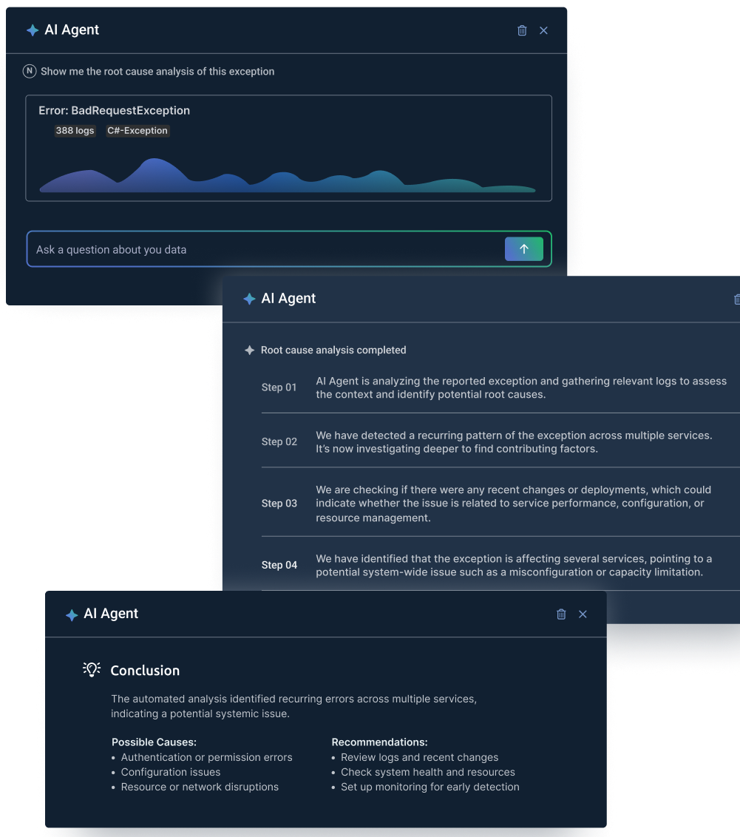
A note on AI
Really good for text/unstructured logs
Good for helping non-technical people query logs
Potentially good for huge amounts of data
Less benefit when using structured logging
You don’t need AI for basic (statistical) analysis
You don’t need AI for alerting

Slide 16
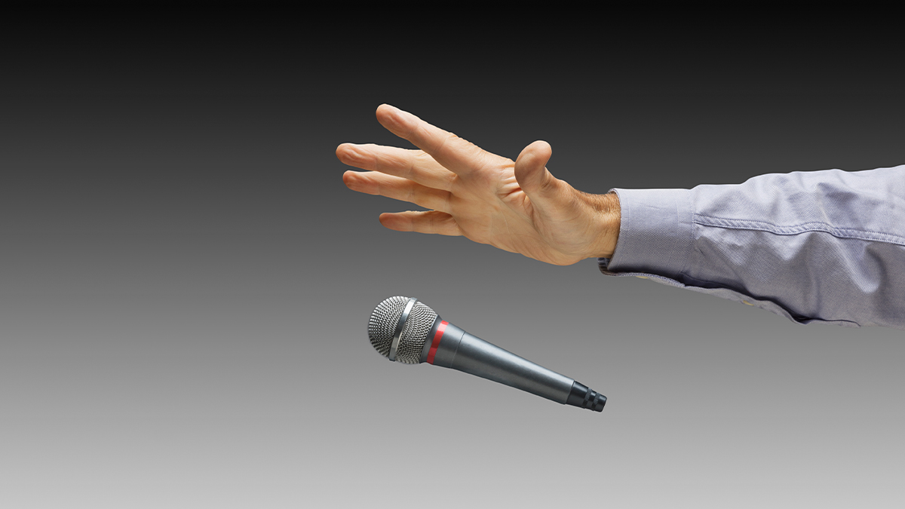

Questions?

